Slide 1
New Monogram Biosciences Testing Capabilities: Influenza, RSV, Ebola and Other Respiratory and Enveloped Viruses

Slide 2
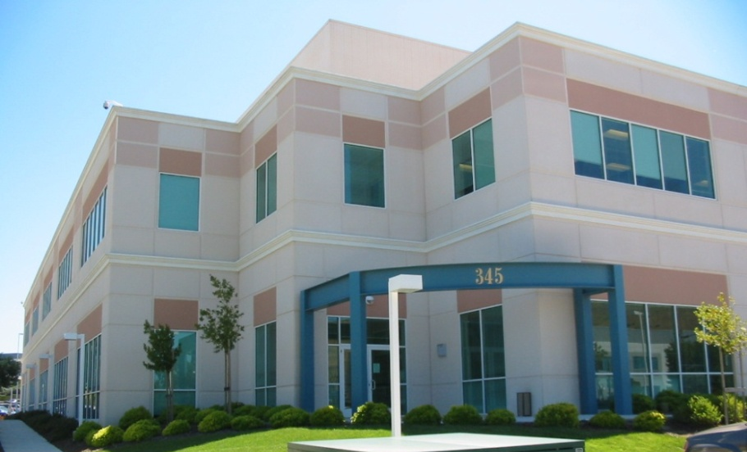
Monogram Biosciences
Monogram was founded in Nov 1995; acquired by LabCorp in Aug 2009
A LabCorp Center of Excellence with a focus on Virology and Oncology
HIV – Leaders in drug resistance
HCV – Full portfolio available
Respiratory Viruses – Novel services
Cancer – Tx response biomarkers
Clinical Reference Laboratory
CLIA/CAP accredited
Clinical patient management
Drug/vaccine development
Science directed
Comprehensive patent portfolio
Longstanding and consistent publication record
History of successful project funding solicitations (grants)
Notes:
2

Slide 3
Monogram: Core Capabilities
Patented diagnostic assay development
Cell-based infectivity assays (PhenoSense)
DNA sequencing assays (GeneSeq/GenoSure)
Protein and protein complex assays (VeraTag)
Bioinformatics
Phenotype-genotype correlations
Correlates of clinical outcomes
Drug and vaccine evaluation/development
Clinical Reference Laboratory Engineering

Slide 4
New Monogram Biosciences Virus Testing Capabilities
GenMark Respiratory Virus Panel (RVP)
Can test 10, 14 or 19 virus panels
Includes subtyping of Influenza, RSV and other respiratory viruses
Validated for multiple sample types:
Nasopharyngeal Swabs , Nasal Swabs and Blown Mucus
Cell-Based Neutralizing Antibody and Drug Susceptibility Testing
High throughput characterization of new and existing anti-viral compounds against a panel of clinical isolates and reference strains
Influenza A and B, RSV A and B, Ebola

Slide 5
New Monogram Biosciences Virus Testing Capabilities
Sequencing
Sanger: HIV genes, Influenza A/B HA and NA; RSV A/B F, G and SH genes; HRV capsid (VP1)
NGS
HIV – PR/RT, Gag, Env, Integrase, RNase H
HCV – sequencing all NS targets and genotypes
HBV- P (polymerase, RT) and C (core)
RSV- P (polymerase) and F (fusion), G and SH env genes
Other: if we can amplify the region, then we can sequence the region

Slide 6
New Monogram Biosciences Virus Testing Capabilities
qRT-PCR
Influenza A/B
RSV (in development)
Other sequencing and qualitative or quantitative RT-PCR assays can be developed and validated upon request

Slide 7
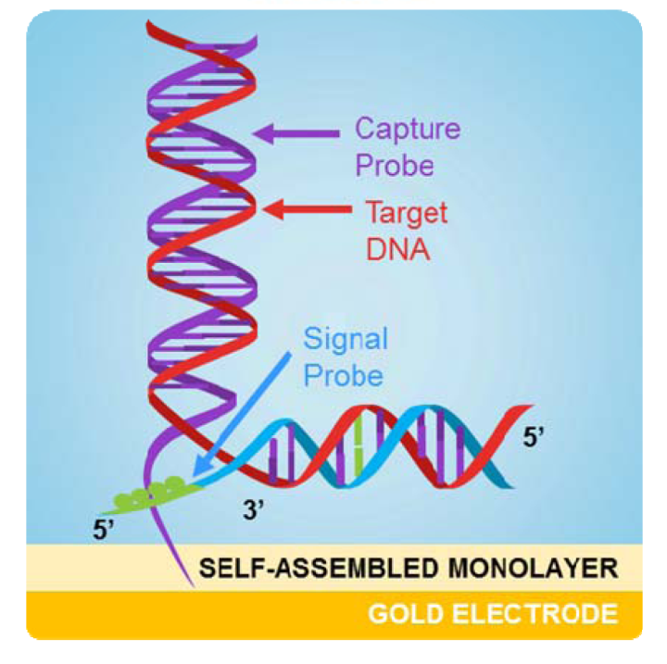
GenMark: Respiratory Virus Panel
GenMark Dx eSensor RVP
IVD (FDA approved)
Qualitative detection of 14 respiratory viruses
Influenza A,
Influenza A H1 Seasonal Subtype,
Influenza A H3 Seasonal Subtype
Influenza A 2009 H1N1 subtype
Influenza B
Respiratory Syncytial Virus subtype A,
Respiratory Syncytial Virus subtype B
Parainfluenza Virus 1
Parainfluenza Virus 2
Parainfluenza Virus 3
Human Metapneumovirus
Human Rhinovirus
Adenovirus species B/E
Adenovirus species C.
Additional virus detection available:
Parainfluenza Virus 4
Coronavirus 229E
Coronavirus NL63
Coronavirus HKU1
Coronavirus OC43
Notes:
7

Slide 8
Influenza Example: Hemagglutination Inhibition Assay vs. Monogram Influenza Neutralization Assay
 | HAI | MGRM Influenza Neut Assay
Method | “Gold Standard” conventional influenza serological assay; 50 year old technology. | Novel recombinant pseudovirus infectivity/neutralization assay based on Monogram’s well-published PhenoSense platform technology.
Reproducibility | Varies lab to lab, and by reagent (erythrocyte, Receptor destroying enzyme, virus input) lots over time; variability up to 32 fold (112% GCV) (Wood et al, Vaccine, 1994) | Standardized and QC’d reagents Reproducibility excellent - IC50s within 2-fold
Automation | No | Automated format run in CLIA-CAP accredited clinical reference lab
Throughput | Low throughput (Manual process) | High throughput >1000 IC50’s/day “No project is too large”
Sensitivity | Insensitive | >10x more sensitive than HAI.
Biosafe system? | No | Yes
Data interpretation | Subjective | Objective
Data output (report) | Binary output: +/- HAI titer is last dilution that completely inhibits hemagglutination | Quantitative output. Full 10 point inhibition curves with IC50’s reported.
Applicability across new virus subtypes, influenza B, H5 and H7 | Different erythrocytes may be needed for certain strains, e.g. Horse erythrocytes required for H5, H7 | Ability to measure neutralization against H5, H7, and all seasonal flu strains without modification to platform

Slide 9
HIV Reporter Pseudovirions
with HIV-1 Envelope or Influenza HA/NA
H
N
H
N
N
H
H
N
N
H
H
N
N
H
H
N
H
H
N
H
N
Patient HIV-1 env
Influenza HA and NA

Slide 10
Respiratory Virus Entry and nAB Assay: Influenza Example
HIV genomic luc vector
gag
gag
luc
pol
luc
pol
HEK-293 Cells
Flu HA and NA expression vectors
HA
NA
Transfection
HEK-293 Cells
TMPRSS2 expression vector
Neut (-)
T2
Infection
Incubation with
antibodies or
plasma
Neut (+)

Slide 11
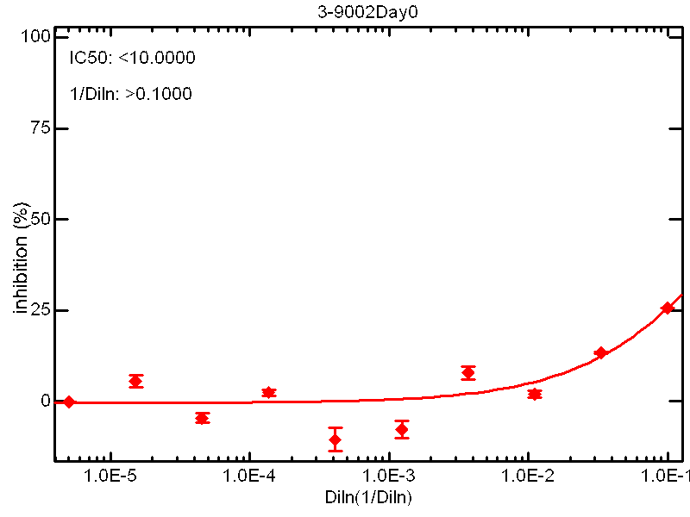
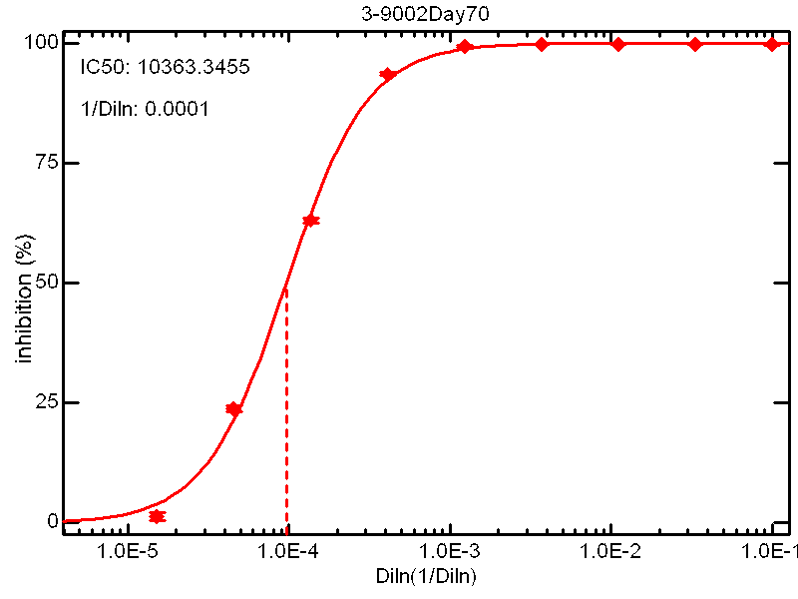
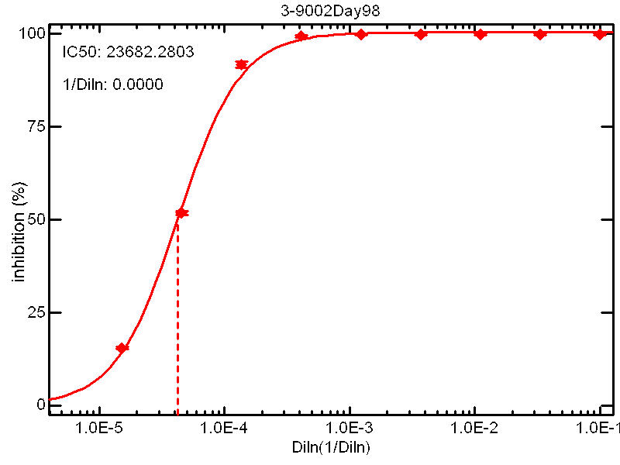
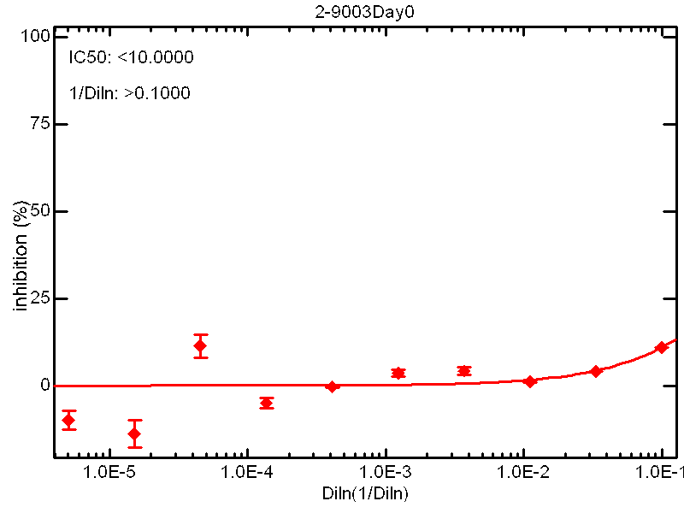
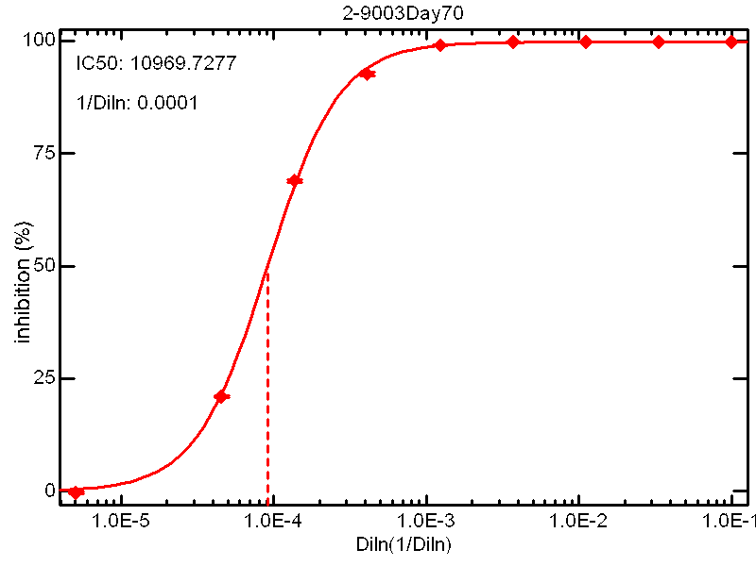
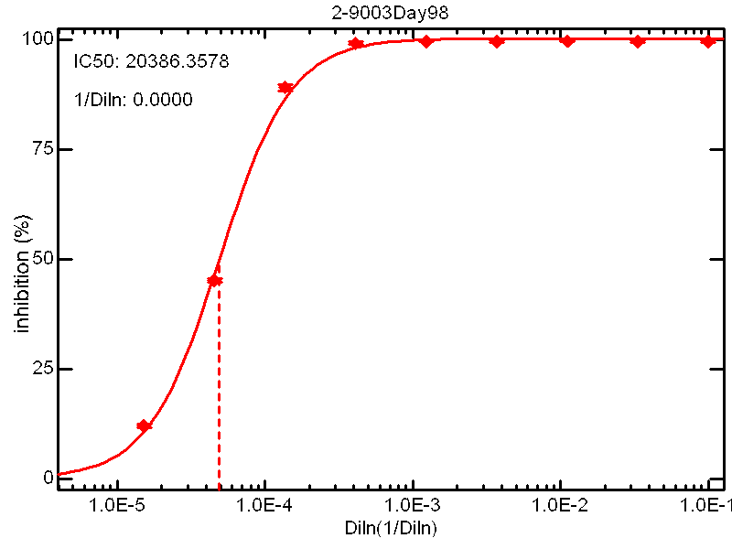
Representative Anti-HA Antibody Inhibition Curves (Rabbit Sera)
pre-immune sera
week 10 immune sera
week 14 immune sera
Virus 1
Virus 2
Notes:
11

Slide 12
Contact Information
For more information on these and other Monogram Services, please contact:
Andrew Gale
Senior Director, Business Development
galea@labcorp.com

